Slide 1
Devops Demo

Slide 2
Agenda
Devops LifeCycle
POC Flow Diagram
Concepts used in POC
Demo
Q&A
Devops & its Evolution

Slide 3
Devops & its Evolution
WaterFall Model
Agile Model
Iterative Based Approach.
Allows testing of every small piece of code.
Very useful when Requirements changes time to time.
Devops
Provides End-to-End Business Solution and fast delivery.
Focusses primarily on Collaboration between teams.
Jenkins,Puppet,Chef,Ansible,GIT,Docker are some of popular Devops Tools.
Requirements
Design
Implementation
Verification
Maintenance

Slide 4
Devops LifeCycle
Continuous Development
Code
Build
Test
Deploy
Monitor
Plan
Release
Operate
Continuous Monitoring
Continuous Integration
Continuous Deployment
Continuous Testing
Continuous Operations

Slide 5
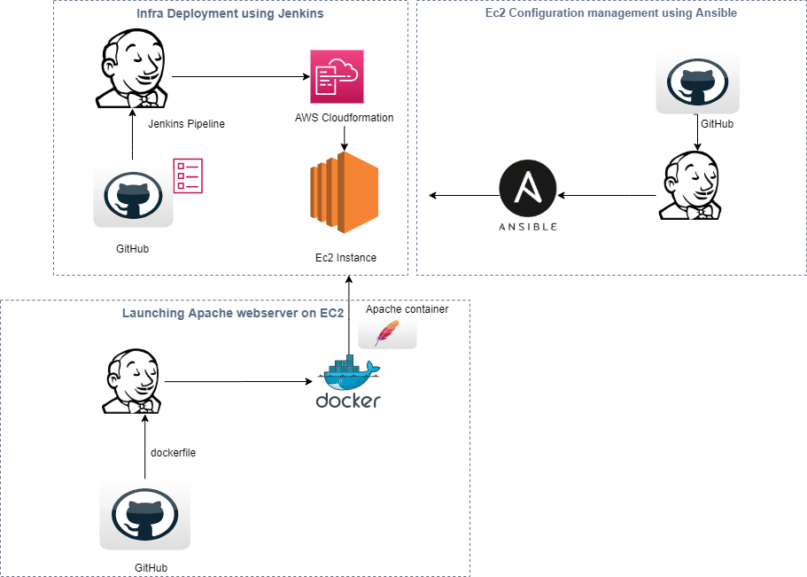
POC Flow diagram

Slide 6
GITHUB
Powerful Source Code Repository
Commands:
→ Git PULL
→ Git add <filename>
→ Git status
→ Git commit –m “commit name”
→ Git Push origin master
Allows tools like Jenkins to trigger Code Build automatically using WebHooks.

Slide 7
Jenkins
Open Source and Powerful CI/CD Tool.
Integrated with number of Tools in the form of Plugins.
Can connect with multiple nodes.
Can Build, test and deploy applications at fast pace.
Can handle multiple WorkFlows in the form of Pipeline.

Slide 8

AWS CloudFormation
Easy way to create and manage AWS Resources.
Template
FrameWork
Stack
YAML/JSON Formatted file.
Defines Parameters, Resources etc
Framework that creates, updates stack from template
Configured AWS Resources.

Slide 9
Ansible
Powerful configuration management tool.
Ansible Role
defaults
Main.yml
files
handlers
Main.yml
tasks
Main.yml
vars
Main.yml

Slide 10
Docker
Tool that helps to run applications in form of containers.
Dockerfile to say what contents image should have.
DockerHub to store images.
Improves portability of application to great extent.
Commands:
Docker build –t <imagename> <dockerfile>
Docker run –name <contname> –d –it –p <imagename>
Docker ps -a
Docker exec –it <contname> /bin/bash

Slide 11


Slide 12


Slide 13
THANK YOU

